Slide 1
Technical Overview Architecting Advanced Analytics With Microsoft R Server
<Presenter Name>
<Contact Info>
<Date>

Slide 2









Microsoft’s approach to advanced analytics
Scale
Agility
Low cost
Hybrid
Works with what you have
AI Driven Innovation
Solutions to accelerate time to value
Notes:
Slide Objective:
Show the three pillars of Microsoft Advanced Analytics
Talking Points:
Microsoft’s Advanced Analytics products work with all your current investments – we support different platforms like Windows, Linux, SQL, Terada and even Big data. It works both on premise and in the cloud
Microsoft has for long been investing in innovative Artificial Intelligence technologies and baking them into our products like Cortana, HoloLens, Bing and Skype. We are now commercializing these technologies through our advanced analytics products including Microsoft R.
Microsoft want to help you accelerate the process of generating value from your data – which is why we are not only building the tools but investing heavily in creating solutions that can help you drive value.

Slide 3










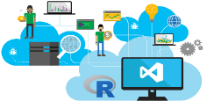







We are building intelligence into every product at Microsoft
SQL Server + R
Microsoft R Server
Hadoop + R
Spark + R
Microsoft CNTK
Cortana
Azure Machine Learning
Cortana Intelligence Suite
R Tools/Python Tools for Visual Studio
Azure Notebooks
(JuPyTer)
Cognitive Services
Bot Framework
Office 365
Hololens
Bing
Skype
Xbox 360
Dynamics 365
Notes:
Every platform is infused with intelligence. It’s a rich and comprehensive collection for the needs of every type of developer.
SQL + R (w/ SSIS/SSRS reports/BI, etc. basically coming for free)
MRS
Hadoop + R
Spark + R
CNTK
Azure ML
Cortana Intelligence Suite
JuPyter Notebooks
Message #1: You, customer, take PROS example and envision other scenarios à in finance, banking, retail, healthcare, manufacturing…
Message #2: Take your CRM, ERP, DW, OLTP, BD… various workloads + add AA to it!!
Message #3: Wherever you are “in the intelligence food chain”, we have a solution for you! – from experts/rocket scientists (MRS/DNN) to amateurs (Cortana Gallery and CIQS/CAQS – templatized solution)
Message #4: We have templatized solutions for you to start with right now Horizontal SaaS (w/ predefined models, vertical templates, etc.) – e.g., RR Predictive Maintenances, etc.
Message #5: Trial experience of AA aps is easy and free – consistent across the board.

Slide 4

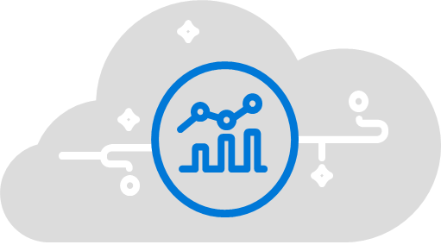
Microsoft advanced analytics
Solutions
Microsoft R
SQL Server 2016
Cortana Intelligence
R-based analytics
In database analytics
Cloud analytics
Notes:
To help us meet these goals, we have three main products
Cortana Intelligence Suite
Cognitive Services, Bot Framework, Cortana
Power BI
Machine learning, Stream Analytics, HDInsight
Data Lake, SQL, DW
Data Factory, Data Catalog, Event Hubs
SQL Server 2017
SSRS, DataZen, R
SSAS, SQL Server Machine Learning Services
OLTP, DW, Hadoop, EDSs
SSIS, DQS, MDS
Microsoft R
R visualizations
Microsoft R
Hadoop, Teradata, Linux, Windows
Spark SQL/ETL

Slide 5






Microsoft’s investment principles for R
Enterprise grade operationalization and support
The flexibility to work with what you have
Best of Open Source and Microsoft innovation
Accelerated time to value with solutions
Rapidly growing library of 10,000+ packages
Operational in SQL or in web apps
+
Works across your analytics environment
Hybrid
24/7 enterprise grade support
Scalable algorithms and Microsoft Machine Learning Libraries
Marketing Campaign Optimization and other solutions to help you derive value
Works on premise and in the cloud
+
Built on top of Open Source R with access to all 10K+ CRAN libraries
CRAN is the “Comprehensive R Archive Network”
Notes:
CRAN - Growing library of over 10,000+ R packages built by a thriving open source community. Huge repository of freely exchanged, algorithms, techniques, scripts, adapters, techniques, training available.
Enterprise Grade Analytics Platform –
Solve for operationalization challenges using Microsoft R’s ability to write the code once and deploy on multiple platforms.
Get enterprise grade support and safeguard your analytics investments.
Works with what you have –
We understand your data lives in different environments and your needs may change over time which is why Microsoft R supports several platforms like – Hadoop/Spark, Linux, Windows, Teradata, SQL
Best of Open Source and Microsoft innovation
Parallelized, remote executing algorithms
In-database analytics to take analytics to your data
Machine learning packages from Microsoft
Time to value
Solution templates, tutorials to help you build solutions
Microsoft’s partner ecosystem to help you execute projects.

Slide 6
Microsoft R: A functional introduction

Slide 7
Challenges Faced
Broaden access to data science capability
Analyze large, complex data sets of people, events
Ability to scale analytics to large data
Embrace emerging platforms on-prem and cloud
Bring analytics to production platforms
Rapidly create and deploy intelligent apps
Embrace hybrid cloud architectures
Achieve data science agility
Maximize talent base (current and future)
Plan transitions to future platforms

Slide 8
Microsoft R Server: The Enterprise Enhanced R Platform
Multiplatform R analytics for building smart enterprise apps that:
Scales analytics to big data
Analyzes big data without moving the data
Streamlines smart application deployment
Integrates with traditional application tools
Brings artificial intelligence into your apps
Reduces future architectural disruptions
With Microsoft R you can:
Choose the tools you prefer
Scale your analytics to big data for better insights
Embrace combined open source & commercial innovations
Get the support that you trust

Slide 9
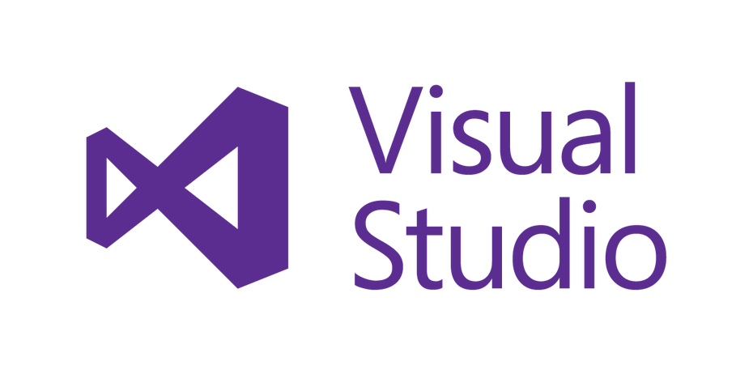



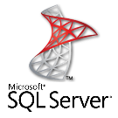










Microsoft R Server Version 9 at a glance
Tools
Operationalization
Rattle
Mrsdeploy RESTful API deployment
Languages
Algorithms
Open source R algorithms & visualizations:
CRAN
bioconductor
Distributed Parallelized Algorithms:
RevoScaleR library
MicrosoftML library
Custom parallelization frameworks
Plus:
Deep Learning
Pretrained Models
Prebuilt Featurizers
In-database deployment
Data Sources
Real-Time Scoring
Visualization Tool Integration
.csv
Microsoft .XDF
ODBC/JDBC
Platforms & Data

Slide 10
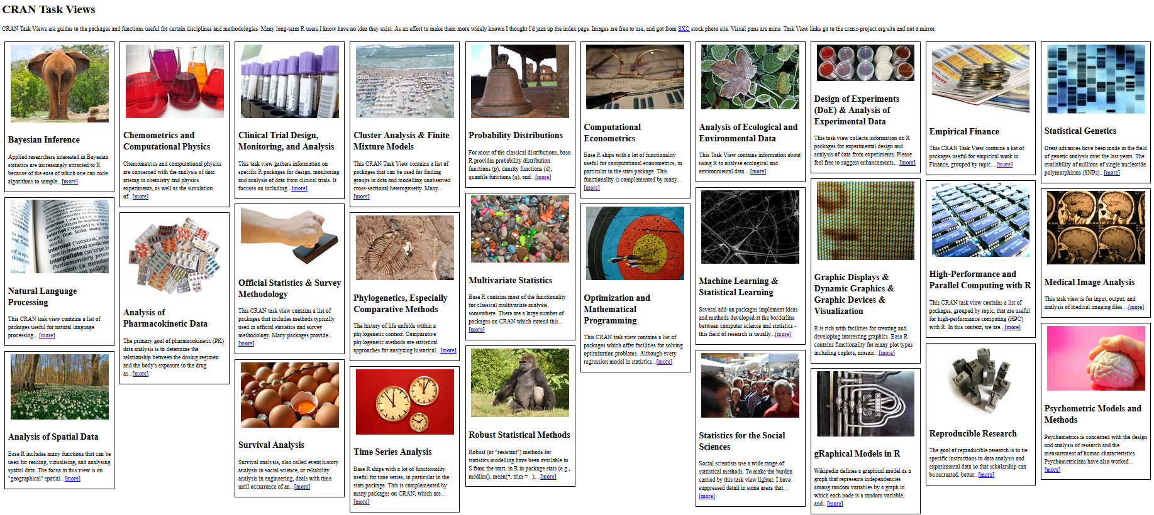
CRAN: 10,000 packages and growing… (who could possibly ask for more??)

Slide 11
Open Source R limitations to consider:
While very well adopted, changing data needs are affecting R’s usability for emerging big data analytics tasks:
Scale:
Limited data scale
Speed:
Speed of analysis suffers as data grows
Support:
Inadequacy of Community Support
Application Governance:
Commonly prohibited in production systems without commercial vendor

Slide 12
The best of open source & Microsoft technologies
Choice
Open Source: Microsoft R Open:
100% open source R
CRAN, Bioconductor compatibility
Microsoft innovations: Microsoft R Extensions:
RevoScaleR
Parallelized, distributed algorithms
Microsoft Machine learning
Fast and Deep learning
Pretrained models
“Many models”
Custom parallel frameworks
Tools
Operationalization
Language
Algorithms
Data Sources
Platforms and Data
Open source R algorithms & visualizations:
CRAN
bioconductor
Distributed Parallelized Algorithms:
RevoScaleR library
MicrosoftML library
Custom parallelization frameworks
Plus:
Deep Learning
Pretrained Models
Prebuilt Featurizers

Slide 13

RevoScaleR: Parallel, distributed algorithms
Data Step
Data import – Delimited, Fixed, SAS, SPSS, OBDC
Variable creation & transformation
Recode variables
Factor variables
Missing value handling
Sort, Merge, Split
Aggregate by category (means, sums)
Statistical Tests
Chi Square Test
Kendall Rank Correlation
Fisher’s Exact Test
Student’s t-Test
Variable Selection
Stepwise Regression
Simulation
Simulation (e.g. Monte Carlo)
Parallel Random Number Generation
Sampling
Subsample (observations & variables)
Random Sampling
Cluster Analysis
K-Means
Descriptive Statistics
Min / Max, Mean, Median (approx.)
Quantiles (approx.)
Standard Deviation
Variance
Correlation
Covariance
Sum of Squares (cross product matrix for set variables)
Pairwise Cross tabs
Risk Ratio & Odds Ratio
Cross-Tabulation of Data (standard tables & long form)
Marginal Summaries of Cross Tabulations
Predictive Models
Sum of Squares (cross product matrix for set variables)
Quantiles (approx.)
Generalized Linear Models (GLM) exponential family distributions: binomial, Gaussian, inverse Gaussian, Poisson, Tweedie. Standard link functions: cauchit, identity, log, logit, probit. User defined distributions & link functions.
Covariance & Correlation Matrices
Logistic Regression
Linear regression
Predictions/scoring for models
Residuals for all models
Classification
Decision Trees
Decision Forests
Gradient Boosted Decision Trees
Naïve Bayes
Custom Parallel
rxDataStep
rxExec
rxExecBy – Many-Models
PEMA-R API Custom Algorithms
Notes:
Slide Objective
Present the range of already parallelized functions and algorithms available with RevoScaleR
Talking Points
This list shows the functions and algorithms that are available with all versions of R Server.
We call this the ScaleR Library.
Each function can:
Execute work in step in parallel or serial as needed
Process work using multiple threads, cores, sockets or nodes
Process one or more data block in each thread, core, socket or node
Combine the results into a single mathematically correct answer
Do the work either locally or ship the request to another system for completion remotely.
Completely obscure the complexity of parallelization, multiple steps and iterations from the R programmer
Four functions, rxDataStep, rxExec, PEMA-R, and the newest rxExecBy provide frameworks for users to write their own routines – functions – algorithms using parallelization.
While more difficult than pre-written PEMAs, the results are portable – usable on multiple systems
Easier than writing directly to the platform to create custom algorithms.
Notes:
One algorithm framework – PEMA-R API, is not available in clustered systems – an exception to creating portability across systems.

Slide 14
Microsoft Machine Learning
Innovations built and proven in Microsoft Bing
Parallelized for scale & speed
Available on Windows & select Linux & Hadoop platforms
Learner | Strength | Learning tasks supported | Sample Applications
Deep Neural Network | Supports custom, multi-layer network topology with filtered, convolutional, and pooling bundles | Binary classification Multi-class classification Regression | Bing Ads Click Prediction ($50M per year revenue gain); Image Classification
Logistic regression | L1, L2 regularization | Binary classification Multi-class classification. | Classifying user feedback
One-class SVM | Easy to train learner for anomaly detection | Anomaly Detection | Fraud detection
Fast Tree | Boosted decision tree. Similar to XGBoost. Supports upto 1B features! | Binary classification Regression | One of the most popular and best performing learners inside Microsoft.
Fast Forest | state-of-the-art tree ensembles (Random Forest) | Binary classification Regression | Churn Prediction
Fast Linear (SDCA) | Speed, scalability and supports L1,L2 regularization | Binary classification, Regression | Outlook used for email spam filtering
Linear, Logistic & Tree Learners
Pretrained Models
Deep Learning
Transform | Strength | Description | Applications
Text | Battle tested, large language support, performant (Bing, Office) | Performs natural language processing of free text into numerical representation. | Support ticket classification, Sentiment analysis
Categorical / Categorical hash | Ease of use; 1 line of code to set | Converts categories into numerical data. | Ad Click Prediction
Feature Selection | Ease of use | Selects a subset of features to speed up training time. | Sentiment analysis, Ad Click Prediction
Notes:
These machine learning algorithms evolved out of Microsoft Research and into product teams such as Bing, Office, XBox, Skype and Windows
Battle tested in real-world production scenarios, these algorithms have been proven to be robust and scalable in key Microsoft products used by millions of Microsoft customers worldwide.
These state-of-the-art ML algorithms are now available to anyone outside of Microsoft via Microsoft R Server.
========
FastTree => Better and Faster than H2O algos
FastTree and Fast Forest => In Memory algorithms
Fast Linear => Can deal with lots of features (1 Billion)
Lot of Text learners included => Tokenization, language identification, TFI, DF, Ngram, Chargram, Easy to use, Streaming
OneClassSVM => Anomaly, Unbalanced
============
Demops:
Criteo: Clickstream, predict click through for ads, 1TB dataset, 1 hour, Million features
Cats vs Dogs (SQL): DNN featurizer pre-trained on 1M images, Binary classification model
Twitter sentiment => 1.5M tweets (positive, negative, neutral)…against H2O

Slide 15
Pretrained Text, Image & Sentiment Models New in R Server V 9.1
Pretrained
Image Featurization
FeaturizeImage()
Used to identify parts of images
People, things, animals, etc.
Image
Data Sets
Featurizer
Image contents found
Image contents
Featurizer
Featurizer
Text Featurization
FeaturizeText()
Returns Ngram digest & counts from many partitions of text data
Text
Data Sets
Featurizer
Ngrams (phrases)
counts
ngram
Featurizer
ngram
Featurizer
ngram
Pretrained Sentiment Analysis
GetSentiment()
Pretrained to return sentiment score (0-1)
English only for now
Text
Data Sets
Featurizer
getSentiment()
Sentiment Score
Featurizer
Featurizer

Slide 16
Analyze diverse data sets easily
Distributed Modeling
New partitioned and ensembled modeling tools
“Many Models” on Partitioned Data
Train multiple models on partitioned data
Parallelized for Hadoop/Spark modeling
Parallelized ensemble modeling
New rxExecBy framework:
More powerful than rxEXEC
Reads from data sources directly
Provides groupby semantic directly
Superior to Spark gapply:
6x+ faster
Greater scalability
Tools
Operationalization
Language
Algorithms
Data Sources
Platforms and Data

Slide 17
Ensemble Modeling
What is it?
A process wherein multiple models are trained, and then mathematically combined into a single, more accurate model.
A range of techniques – some well known modeling techniques are based internally on an ensembling method - Random Forest, for example ensembles multiple decision trees.
Typically, ensemble modeling refers to a set of means of combining multiple similar models
A technique made practical by the advent of massively parallel compute such as Apache Spark environments.
A new technique for improving model accuracy that is available in Microsoft R Server v9.1

Slide 18
“Many Small Models”?
What is it?
A way of improving modeling accuracy by creating models for specific cohorts or groupings of data.
A way of reducing the coding effort that would be required otherwise.
Example: Demand prediction
A store has many categories of products. They want to predict sell-through by category, A single model of all categories produces poor accuracy because of wide variations in behavior.
The task of scripting model training on hundreds of categories is not only tedious, but ever changing, making the task untenable.
Many Models enables them to divide history data by product category, and then run a many model training on the data in a single task, slashing coding.
The result is a family of models that collectively provide far greater accuracy than a single model for the entire product line offered.
Example: Failure rate prediction
A machine maker builds many different types of machines suited to many different applications and environments.
Failure rates correlated to very different environmental variables depending on machine type and size, usage environment, etc.
A single model of these diverse machines wouldn’t yield good accuracy, and building many different models by hand is too tedious.
The process begins by categorizing groups of machines, environments, users, etc. that behave similarly and repartitioning the data according to this classification.
Then modeling is done with “many small models” using rxExecGroupby resulting in a family of models that each accurately predict a single category of cohort.

Slide 19
Enhanced modeling techniques: Ensembles & “Many Small Models”
Ensemble Learning
rxEnsemble:
Returns ensembled model combining multiple types
Ensembling settings balance speed & accuracy
Single or Distributed
Data Sets
Model 1
rxEnsemble
Ensemble Model
Model 2
ManyModels:
Used to run model on each of many partitions.
Returns one model trained to per cohort (partition) of data.
Many Small Models
Data Partitioned by Cohort
P1
Model P1
Returns a set of Models
Model P1
P2
Model P2
Model P2
P3
Model P3
Model P3

Slide 20
Scale your analytics to big data
Scale
RevoScaleR
Parallel distributed algorithms, transforms, tests, and scoring
Platform independent
Linear scale-out & scale-up
Microsoft Machine Learning Library
Fast distributed analytic algorithms
Deep learning tools
Many-models on partitioned data
Ensemble learning on partitioned data
Pretrained Sentiment & Image Featurizers
Create custom parallel algorithms and functions:
PEMA-R, rxExec, rxExecBy & rxDataSetp frameworks
Tools
Operationalization
Language
Algorithms
Data Sources
Platforms and Data
Open source R algorithms & visualizations:
CRAN
bioconductor
Distributed Parallelized Algorithms:
RevoScaleR library
MicrosoftML library
Custom parallelization frameworks
Plus:
Deep Learning
Pretrained Models
Prebuilt Featurizers

Slide 21
Scale your R environment with Microsoft R
Cloud
Big Data
R Server for HDInsight
Linux and Windows Servers
Virtual Machines
Data scientist
workstation
Hybrid
Our data science tool that allows you to do high performance analytics on production data, running locally on your computer
On-premises
Big Data
R Server for Hadoop/Spark
In-Database
SQL Server 2016 (R Services)
R Server for Teradata
Linux and Windows Servers
R Server for Linux and Windows
R Client (free)
Notes:
On the left we have left we have R client which offers two things to data scientists
They can leverage all the Microsoft R packages locally on their workstations
Second, they can push the compute and bid data analytics to where the data lives. This gives them access to the power of servers and eliminates need for data movement, reducing time and increasing security
On the right is our commitment of meeting customers where they are, and where their data lives.

Slide 22
Approaches to scaling & accelerating R
Open source
Single threaded execution – slow and memory limited.
Scale the Environment
Move modeling, testing and evaluation to faster systems with more memory.
Parallelize Math Primitives
Multi-threaded math primitives from Intel Math Kernel Libraries (MKL).
Embarrassingly Parallel Functions
Parallelize record-by-record tasks – “do parallel” – a.k.a. “pleasingly parallel”.
Custom Algorithms
Build custom parallelized algorithms.
Distributed Algorithms
Refactor algorithms for distributed computation – e.g. multi-threaded, multi-core.
Multi-Node Parallelization
Refactor algorithms for distributed computation on multiple nodes.
Remote Execution
Move analysis to where data lives.
Ensembling
Parallelize modeling & ensemble multiple results.
Many Models
Compute unique models for each group, partition or cohort.

Slide 23
Tackle bigger data with Microsoft R
Open Source R is designed to use only a single thread (processor) at a time
Open Source R
Microsoft R allows you to scale your analytics with enhanced performance using multi-threaded parallelized algorithms
Microsoft R
Parallel Worker tasks
CPU
CPU
CPU
CPU
CPU
Notes:
Slide Objective:-
Show how Microsoft R outperforms Open Source R
Talking Points:-
Open Source R libraries are single threaded and all computation happens sequentially.
Microsoft R offers scalable parallelized algorithms that use R Server’s multithreaded processing to offer superior performance.
The multi-core machines of today offer parallel processing power. To take advantage of this, Microsoft R provides multi-threaded math libraries. These libraries automatically use all available cores and processors to significantly reduce computation times — without the need to change a line of your R code.

Slide 24

Big data scale with Microsoft R Server
Scale via parallel & distributed computation
Scales via in-cluster & in-database execution
Escapes R’s memory limitations
Speed analysis by reducing data movement
Stop security risks with in-database & in-Hadoop
Deploys R to multiple platfroms
Task
f(x)
Task
Task

Slide 25
Speed your analytics with parallel algorithms
RevoScaleR Algorithms & Functions
… load a large dataset
Model_obj <- rxLinMod(…) … run a RevoScaleR algorithm
Task
Initiator
Finalizer
Task
Data Larger than RAM
Task
Typical Characteristics
One call, one answer
Arbitrarily large data sets
Arbitrarily large worker task set
Mathematically the same as single-threaded
Platform independent
Most are written in C++ for speed
Internal Flow:
Algorithm begins initiator process
Initiator distributes work to nodes
Finalizer collects results
Finalizer iterates or continues
Finalizer evaluates final model
Returns single model to calling script

Slide 26
Speed your analytics with Microsoft Machine Learning
MicrosoftML Fast Learners
… load a large dataset
Model_obj <- rxFast Linear(…) … run a MicrosoftML algorithm
Task
Initiator
Finalizer
Task
Data Larger than RAM
Task
Typical Characteristics
One call
One or many models returned
Arbitrarily large data sets
Arbitrarily large worker task set
Augments RevoScaleR
Fast learners & Deep Neural Networks
Use with rxEnsemble to combine models
Returns ensembled model combining multiple types
Combine with rxExecBy for GroupBy operations
Supports Many-Models
One model per data partition

Slide 27

Scale by moving analytics to the data…
RevoScaleR Remote Execution
Local RevoScaleR Algorithm
Remote RevoScaleR Algorithm
Remote Local
Initiator
Task
Finalizer
Task
Big data
… set compute context to Spark
rxSetComputeContext(RxSpark(…))
Model_obj <- rxLinMod(…) … run a RevoScaleR algorithm
Algorithm Interface
Task
SQL Server, Teradata, Hadoop, Hadoop MapReduce, HDInsight
Internal Flow:
Algorithm on local checks compute context
If set remote, packages and ships request
Local script blocks (by default) awaiting response
Remote unpacks and executes in parallel
Remote returns results to local interface
Local interface returns results to script
Remote Execution:
Executes RevoScaleR algos on remote data & CPUs
“rxSetComputeContext” redirects to remote
Algorithms in RevoScaleR library redirect as set
Results are returned to script as though local

Slide 28
Remote Execution in MapReduce in script
Define Our Compute Context
Sample R Script:
rxSetComputeContext(RxHadoopMR(…))
inData <- RxTextData(“/ds/AirOnTime.csv”, fileSystem = hdfsFS)
model <- rxLogit(DEP_DEL15 ~ DAY_OF_WEEK + UNIQUE_CARRIER, data = inData)
Define Data Source
Train Predictive Model

Slide 29
Remote Execution in Spark/Hadoop in script
Change the Compute Context
Keep other code unchanged
Sample R Script:
rxSetComputeContext(RxSpark(…))
inData <- RxTextData(“/ds/AirOnTime.csv”, fileSystem = hdfsFS)
model <- rxLogit(DEP_DEL15 ~ DAY_OF_WEEK + UNIQUE_CARRIER, data = inData)

Slide 30
Embrace Spark / Hadoop data lakes
Spark
Distriubte RevoScaleR algorithms using Spark
Spark 1.6 or 2.0 Compatible
Load Spark Dataframes from:
Text, XDF files
Parquet, ORC & Hive data formats
Interop with SparkETL, SparkSQL
Support for HDInsight, Hortonworks, Cloudera & MapR Hadoop
Tools
Operationalization
Language
Algorithms
Data Sources
Platforms and Data
Open source R algorithms & visualizations:
CRAN
bioconductor
Distributed Parallelized Algorithms:
RevoScaleR library
MicrosoftML library
Custom parallelization frameworks
Plus:
Deep Learning
Pretrained Models
Prebuilt Featurizers
.csv
Microsoft .XDF
ODBC/JDBC

Slide 31



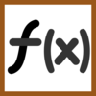


R Server for Hadoop/Spark: In-memory, massive parallelism for R algo’s.
R Server for Hadoop 9.1
Ver. 1.6 or 2.0
Edge Node
Data Frames
Worker Task
ScaleR Master Task
Spark
Executor
Spark Driver
Initiator
Finalizer
Worker Task
Spark
Executor
R User Workstation
Worker Task
Spark
Executor
R Server components installed
YARN Resource Management
.csv, xdf, hive, parquet, ORC
Notes:
Slide Objective
Show how the components of R Server – RevoScaleR algorithms are layered atop Hadoop edge nodes, Spark Drivers and Spark executors.
Talking Points
Working with the Driver / Executor framework of Spark, Microsoft has used it’s DistributedR layer to provide a Spark based framework for running R Server’s massively parallel, remote executable functions and algorithms.
These algorithms make up a library called ScaleR, and the algorithms are platform independent, remote executable and parallelized transparently (so that the user doesn’t have to involve himself or herself in the details the parallelism used to provide big data scale and parallelized compute speed.
R Server for Hadoop is hosted atop the combination of:
Hadoop edge nodes running that run master tasks
Master tasks an initiator tasks that works with Spark to load target data sets into Spark DataFrames in anticipation of running an algorithm
Initiate the algorithm by setting up instructions for spark and invoking Spark jobs to do the algorithm computations on each block of the targeted DataFrame.
Spark Drivers schedule Spark Executors to do blockwise processing.
As executors complete DataFrames processing, additional executor(s) are scheduled to consolidate results from the Spark Executors that run ScaleR worker tasks.
Once results from a “pass” over the data is complete, the consolidated results are processed by the Master Task.
The Master Task finalizer task evaluates the results to determine whether to return, iterate or conduct additional steps.
When determined to have completed satisfactorily, the finalizer returns the results to the calling R script typically running on a client workstation or in R directly on the edge node.

Slide 32





Tool Options for R Server w/ Hadoop/
R Server for Hadoop 9.1
Remote Execution: ssh
Edge Node
Data Frames
R Tools for Visual Studio
Worker Task
ScaleR Master Task
https://
Initiator
Worker Task
Thin Client IDEs
Finalizer
https://
Worker Task
Jupyter Notebooks
Web Services
MRSDeploy
BI Tools & Applications
Notes:
Slide Objective
Show how R Server for Hadoop Spark can interoperate with 4 different methos of development and deployment.
Talking Points

Slide 33
R Server on Spark scales to billions and TBs
Configuration:
HDI cluster size: 100 nodes
Edge node: D14 V2 (16 cores, 112GB)
Worker Nodes: D12 (4 cores, 28GB)
Dataset: NYC Taxi dataset, filtered, transformed, and duplicated
Number of columns: 19
Format: CSV
fs.azure.selfthrottling.read.factor=1
2.2 TB

Slide 34
R & Spark Compared to R & MapReduce
Spark
6x Faster than MapReduce
MapReduce
Local compute
Configuration:
HDI cluster size: 5 nodes
Edge node:D14 V2 (16 cores, 112GB)
Worker Nodes: D12 (4 cores, 28GB)
Dataset: Airlines dataset
Number of columns: 44

Slide 35
R & Spark Compared to Open Source R
rxLogit in HDInsight
(Spark CC)
5 Spark Nodes is 122X Faster than Single CRAN R for GLM
CRAN R glm
Configuration:
HDI cluster size: 5 nodes
Edge node:D14 V2 (16 cores, 112GB)
Worker Nodes: D12 (4 cores, 28GB)
Dataset: Airlines dataset (text format)
Number of columns: 44

Slide 36
R Server & Spark Additional Advantages
Higher Utilization
5x MapReduce on Similar Hardware
Resource Management Flexibility
Multiple Spark clusters per Hadoop cluster
Best of open source R, Apache & Microsoft
R + CRAN
R Server Parallel Algorithms (ScaleR & MicrosoftML)
Web Services Deployment (MRSDeploy)
Plus: SparklyR library to access Spark, MLLIB & other services
Plus: Third Party Ecosystem on Spark

Slide 37
HDInsight: R Server Option takes R Analytics to Spark in the Cloud
10x–50x faster analytics performance with parallelization and in-cluster execution
Work with data within the data lake
Reduce data movement and duplication
Rapid deployment in a managed cloud service. Use computation resources more efficiently
R Server for Hadoop/Spark
Notes:
Slide Objective:
Showcase the possibility of moving R to the cloud, massively scalable by
Talking Points:-
HDInsight is Microsoft’s Hadoop software as a service offering.
R Server is available as an option when provisioning HDInsight in Azure.

Slide 38
SQL Server Machine Learning Services
SQL Server
Fast modeling platform with operationalization in one.
Minimum data movement speeds & secures
Direct T-SQL Integration
Real-Time Scoring Support
SQL Server security & administration
Rapid deployment of R models as stored procedures.
Python support.
Tools
Operationalization
Language
Algorithms
Data Sources
Platforms and Data
Open source R algorithms & visualizations:
CRAN
bioconductor
Distributed Parallelized Algorithms:
RevoScaleR library
MicrosoftML library
Custom parallelization frameworks
Plus:
Deep Learning
Pretrained Models
Prebuilt Featurizers
.csv
Microsoft .XDF
ODBC/JDBC

Slide 39


In-database analytics with SQL Server 2017
Extensibility
Reduce data movement
Eliminate data movement, reduce unnecessary duplication and leverage database data protections
R integration
Python integration
Operationalize scripts and models
Operationalize R or Python scripts & models over SQL Server data by calling familiar T-SQL stored procedures from your application
Data Scientist
Interacts directly with data
Analytics library
R and Python with in-memory scalability
Scale your analytics with multi-threading and massive parallel processing
010010
100100
010101
010010
100100
010101
010010
100100
010101
SQL Developer/ DBA
T-SQL interface
Manage data and
analytics together
Relational data
Notes:
Slide Objective:
Showcase the benefits of Microsoft Machine Learning Services built into SQL Server 2017
Talking Points:-
With SQL Server 2017 – Microsoft has built R as well as new Python services right into the database. This gives you enhanced analytics capabilities while keeping your TCO low.
Reduce data movement – With in-database analytics you can bring the analytics to the data instead of having to make copies of your data which can lead to erroors.
Operationalize R and Python scripts and model – using familiar T-SQL procedures. Reduce the pains of operationalizing your analytics code.
R with in-memory scalability – In-memory analytics gives your data scientists much better speed and performance allowing you to scale to large data sets.

Slide 40
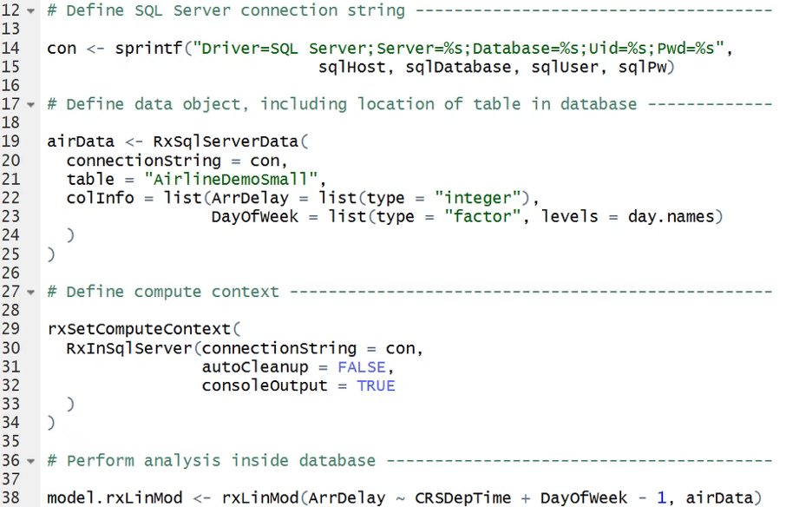

Example: SQL Server 2017 ML Services Coding
Identify Server
Set Source
Set Context
Use

Slide 41
SQL Server Machine Learning Services: Run Machine Learning in the database server
Run R or Python inside SQL Server 2017 with ML Services
Existing SQL 2016 clients can R using SQL R Services
SQL Server 2017
Run R engine from within the Query Processor

Slide 42
Pattern 1: Run R inside T-SQL Combine R and T-SQL for more capable scripting
Combine R and T-SQL and execute via database tools
Combine power of SQL with R for data manipulation
T-SQL Script
SQL Server 2016/17
T-SQL Apps
Run R From within the Query Processor
Move BIG Work to the Data

Slide 43
Pattern 2: Run R transparently for apps Embed R functions in SQL Server for BI, reporting & webapps
Makes the use R analytics transparent to apps
Enables creation of vast array of smart apps using existing platforms & tools
BI & Reporting; Web apps
SQL Server 2016/17
T-SQL Stored Procedure
R Engine
T-SQL Script
R script
Enable smart non-R apps

Slide 44

Pattern 3: Run big analytics close to big data Run R Server parallel algorithms inside SQL Server
R or SQL tools to train models on big data in parallel
Transform large data assets using SQL, R or both
Repeatedly score & rescore large data assets
SQL Server 2016/17
Results
Parallel Algorithm
SQL Applications
T-SQL +
Iterate/ Sequence
Chunk
Remote Execution
Context
Chunk
Parallel
Worker Tasks
Chunk
Large Data Sets in Chunks

Slide 45
Pattern 4: Score large or fast data in real time Run RevoScale models at speed with minimum latency
Score in real-time with minimum latency, max. speed
New for SQL 2017
Examples: fraud detection, anomaly detection
Events
Stored Proc’s and Triggers
SQL Server 2017
Production Apps
T-SQL
Events
Models
Real time scoring engine

Slide 46
Deploy services for intelligent apps
Intelligent Apps
Directly integrate intelligence into apps.
“No conversion” Operationalization
Integrate web apps via Swagger APIs
Integrate SQL apps via T-SQL stored procs
Integrate BI tools via T-SQL or web services
Streamlined real-time scoring:
Low-latency
Faster microbatching
Low resource footprint
Web Services operationalization
Highly-available deployment grids
Secure integration via Active Directory
Mrsdeploy RESTful API deployment
Tools
Operationalization
Language
Algorithms
Data Sources
In-database deployment
Platforms and Data
Real-Time Scoring
Visualization Tool Integration

Slide 47
Operationalization made easy
Deploy to SQL Server
SQL Tools
Dashboards
Custom Apps
Reporting
Use familiar T-SQL stored procedures to invoke R scripts from your application
Deploy to Web Applications
Web Apps
Mobile Apps
Custom Apps
Data Viz Tools
Notes:
Make it easy for enterprises to operationalize new insights
Hybrid, on multiple platforms securely
Deploy within SQL
Web services API

Slide 48


Operationalize Advanced Analytics
Instant Deployment
Deploy to Anywhere
Fast and Scalable
Secure and Reliable
Turn R analytics → Web services in one line of code;
Swagger-based REST APIs, easy to consume, with any programming languages, including R!
Deploying web service server to any platform: Windows, SQL, Linux/Hadoop
On-prem or in cloud
Fast scoring, real time and batch
Scaling to a grid for powerful computing with load balancing
Diagnostic and capacity evaluation tools
Enterprise authentication: AD/LDAP or AAD
Secure connection: HTTPS with SSL/TLS 1.2
Enterprise grade high availability
Notes:
There are many R products in market having Operationalization capabilities. These 4 pillars separate R Server from other R products.

Slide 49


Rapid Deployment for Intelligent Production Apps
Easy Consumption
Explore and consume services in R directly
Data Scientist
Easy Deployment
Turn R into web services in one line of code
Microsoft R Client
(mrsdeploy package)
Data Scientist
Services / Sessions
getService
Microsoft R Client
(mrsdeploy package)
publishService
Microsoft R Server
configured for
operationalizing R analytics
REST API calls
Easy Setup
In-cloud or on-prem
Adding nodes to scale
High availability & load balancing
Remote execution server
Apps
Easy Integration
Swagger-based APIs: easy to consume with any programming language
Developer

Slide 50

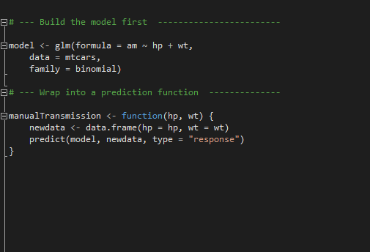
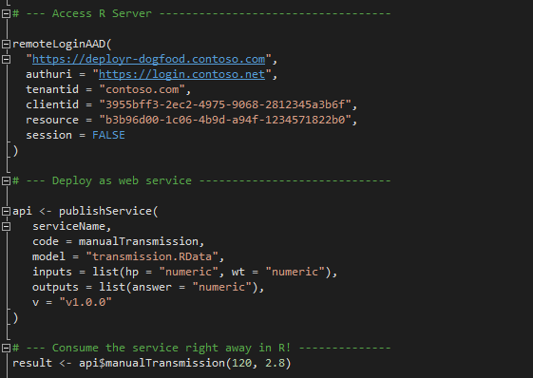
Easy Deployment: One line deployment
Easily create web services from R scripts & models
Build the model first
Deploy as a web service instantly
Notes:
If a version is not specified, a temp guid endpoint is created – this is mainly for development phase and sharing among team members privately.

Slide 51
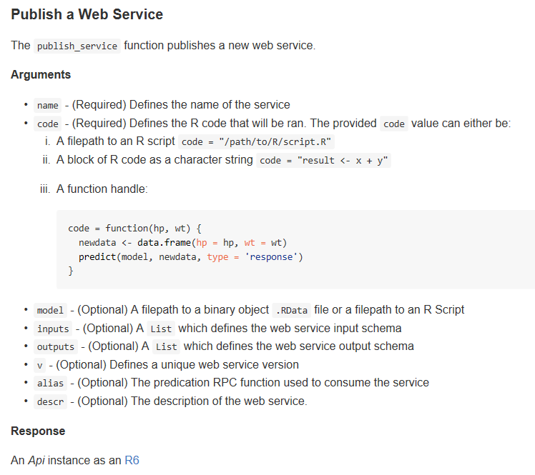
Web Service Functions Cheat Sheet
Function | Description
publishService | Publish a predictive function as a Web Service
deleteService | Delete a Web Service
getService | Get a Web Service
ListServices | List the different published web services
serviceOption | Retrieve, set, and list the different service options
updateService | Updates a Web Service

Slide 52
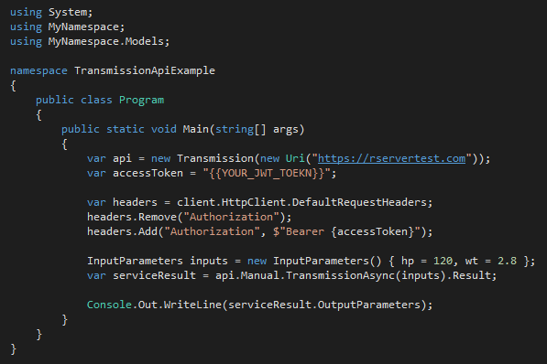
Integration with Apps Swagger APIs simplify consumption of web services
Data Scientist
Developer
Developer
Generate Swagger Docs for Web Services
Run Swagger tools to generate code
Write a few code to consume the service
Popular Swagger Tools: AutoRest or Code Generator
# Run the following code in R
swagger <- api$swagger()
cat(swagger, file = "swagger.json", append = FALSE)
AutoRest.exe -CodeGenerator CSharp -Modeler Swagger -Input swagger.json -Namespace Mynamespace
Notes:
R can be easily integrated via a web service with a C# app. We leverage Swagger to achieve this goal. Swagger is the most popular open source API framework. It greatly simplifies the consumption of RESTful web services. By adding the Swagger description to our RESTful web services, developers can generate the codes easily.
It takes 3 very easy steps to integrate the web service to an application.
First, data scientist generates the swagger doc, with 2 line of code.
Second, developer uses open source tools such as AutoRest to generate the sample code for the web services.
Last step, developer writes a few line of C# codes to consume the service. They will use the autogenerated code. You can see that during the whole process the developers don’t need to see R code at all.

Slide 53
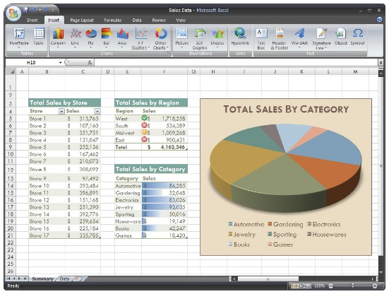
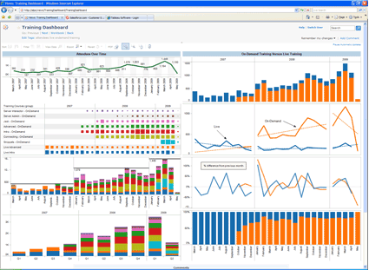
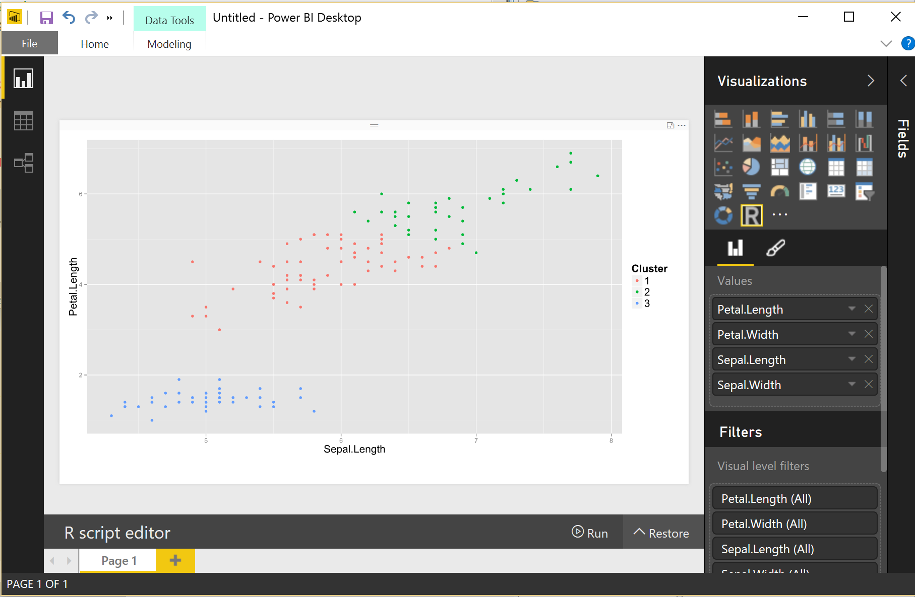
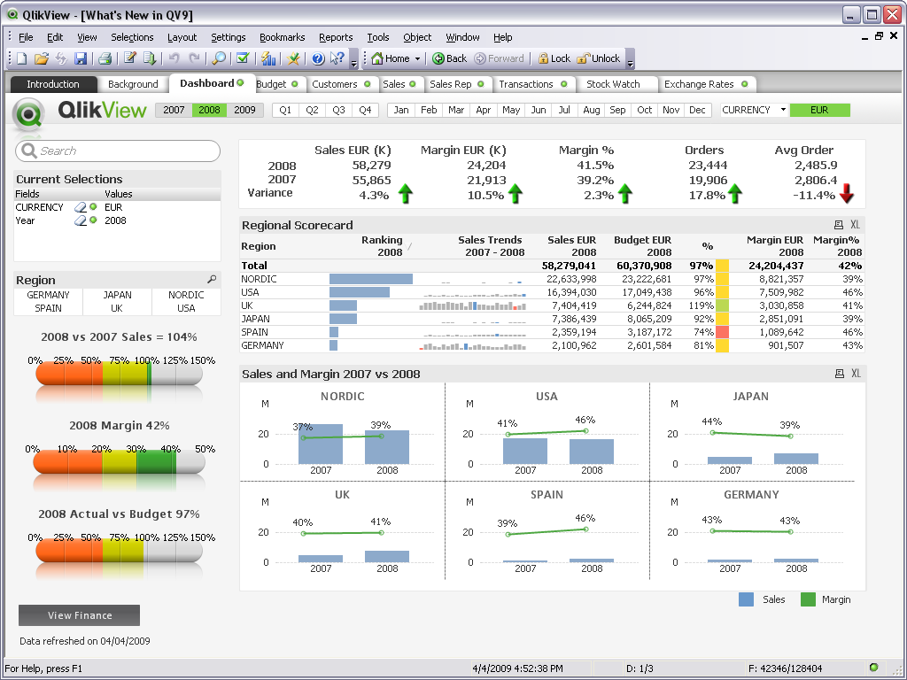
App Integration

Slide 54
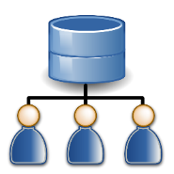
Scalable deployments: MRSDeploy Grids
Apps
Easily scale up a single server to a grid to handle more concurrent requests
Load balancing cross compute nodes
Scale overall performance with shared pools of warmed up R shells.
REST API
R Client
Deploy
Web Node
API/Authentication
Compute Node
Sessions/ Services
Compute Node
Auth.
SQL Server / PostgreSQL DB
Active Directory
Set up a grid to scale computing power
Notes:
Web Node and Compute Node are on separate machine roles
Roles can be scaled independently
Multiple instances per role to allow failover
New machines can be added at runtime without having to restart the service
Web Node instances are stateless, R sessions in Compute Node are stateful
Instances can be taken out of rotation if problem is detected, new requests/sessions are served by healthy instances
Data Store which save the info of sessions and services can sit in a different server box

Slide 55
Secure large-scale deployments: Authentication & Encryption
Seamless integration with authentication solution: LDAP/AD/AAD
Secure connection: HTTPS encrypted by TLS 1.2/SSL
Compliance with Microsoft Security Development Lifecycle
Apps
https:// Encrypted Traffic
R Client
https://
Web Node
API/Authentication
Compute Node
AD/AAD Authentication
Encrypt DB connection info
Encrypt with LDAP-S
Sessions/ Services
Compute Node
SQL Server / PostgreSQL DB
Active Directory
Set up a grid to scale computing power

Slide 56
Assure Highly-available deployments MRSDeploy disaster recovery
Server level HA: Introduce multiple Web Nodes for Active-Active backup / recovery, via load balancer
Data Store HA: leverage Enterprise grade DB, SQL Server and Postgres’ HA capabilities
Web Node 1
Compute Node 1
Apps
Data Store for Sessions / Services
Load Balancer
Web Node 2
Compute Node N
Notes:
Set up multiple web nodes in different machines, and manage them via a load balancer.
Each web node connects to all the Compute Nodes
When one of the web nodes fail, the rest web nodes can ensure the normal operations of the grid.

Slide 57
Also Execute R scripts remotely Configure your R Server to host remote R sessions
Built-in remote execute functions in R Client/R Server
Tools to reconcile local and remote
Execute .R script or interactive R commands
Return results to local
Generate working snapshots for resume and reuse
IDE agnostic
Login remote server
Generate Diff report
Reconcile Environment
R Sessions
R Server
configured to
(Support Window Server, Linux Server, Hadoop )
Remote Execute R Scripts
Execute R Scripts
Snapshot remote env.
Logout remote server
“I can offload the function execution for heavy processing to a chunky server”
“I can validate my scripts against production environment before deployment”

Slide 58
Remote Execution Commands
Remote Connection
remoteLogin | Remote login to the R Server with AD or admin credentials
remoteLoginAAD | Remote login to R Server server using Azure AD
remoteLogout | Logout of the remote session on the DeployR Server.
Remote Objects Management
listRemoteFiles | Get a list of files in the working directory of the remote session
deleteRemoteFile | Delete a file from the working directory of the remote R session
getRemoteFile | Copy a file from the working directory of the remote R session
putLocalFile | Copy a file from the local machine to the working directory of the remote R session
getRemoteObject | Get an object from the remote R session
putLocalObject | Put an object from the local R session and load it into the remote R session
getRemoteWorkspace | Take all objects from the remote R session and load them into the local R session
putLocalWorkspace | Take all objects from the local R session and load them into the remote R session
Remote Execution
remoteExecute | Remote execution of either R code or an R script
remoteScript | Wrapper function for remote script execution
diffLocalRemote | Generate a 'diff' report between local and remote
pause | Pause remote connection and back to local
resume | Return the user to the 'REMOTE >' command prompt
Snapshot Functions
createSnapshot | Create a snapshot of the remote session (workspace and working directory)
loadSnapshot | Load a snapshot from the server into the remote session (workspace and working directory)
listSnapshots | Get a list of snapshots for the current user
downloadSnapshot | Download a snapshot from the server
deleteSnapshot | Delete a snapshot from the server
Notes:
Snapshot functions are very useful for remote execution scenarios. It can save the whole workspace and working directory so that you can pick up from exactly where you left last time. Thank about saving and loading a game.
It can also be used when publish a web service to help you handle the environment dependencies. But it might impact the performance of the Request-Response time. For optimal performance, consider the size of the snapshot carefully. Before creating a snapshot, ensure that keep only those workspace objects you need and purge the rest. And, in the event that you only need a single object, consider passing that object alone itself instead of using a snapshot.

Slide 59
Portable Models Enable Hybrid Clouds
Hybrid Clouds
Script & Model Portability
Embed R in stored procedures & triggers in SQL Server
Expose “scoring as a service”
Pattern: Development scale-up:
Build on desktops, test on servers, clusters etc.
Move analytics to the data
Pattern: Cloud data lake:
Model using cloud data lake & Hadoop on-Prem
Deploy scripts & models to SQL, Windows, Linux
Pattern: Model on-prem:
Model in EDW or on-prem data lake
deploy to OLTP or IoT in cloud
Tools
Operationalization
Language
Algorithms
Data Sources
Platforms and Data

Slide 60
Code Portability
ScaleR models can be deployed from a server or edge node to run in Hadoop without any functional R model re-coding for map-reduce
Local Parallel processing – Linux or Windows
In – Hadoop
### SETUP LOCAL ENVIRONMENT VARIABLES ###
myLocalCC <- “localpar”
### LOCAL COMPUTE CONTEXT ###
rxSetComputeContext(myLocalCC)
### CREATE LINUX, DIRECTORY AND FILE OBJECTS ###
linuxFS <- RxNativeFileSystem() )
AirlineDataSet <- RxXdfData(“AirlineDemoSmall/AirlineDemoSmall.xdf”, fileSystem = linuxFS)
### SETUP HADOOP ENVIRONMENT VARIABLES ###
myHadoopCCC <- RxHadoopMR()
### HADOOP COMPUTE CONTEXT ###
rxSetComputeContext(myHadoopCC)
### CREATE HDFS, DIRECTORY AND FILE OBJECTS ###
hdfsFS <- RxHdfsFileSystem()
AirlineDataSet <- RxXdfData(“AirlineDemoSmall/AirlineDemoSmall.xdf”, fileSystem = hdfsFS)
Compute context R script – sets where the model will run
Functional model R script – does not need to change to run in Hadoop
### ANALYTICAL PROCESSING ###
### Statistical Summary of the data
rxSummary(~ArrDelay+DayOfWeek, data= AirlineDataSet, reportProgress=1)
### CrossTab the data
rxCrossTabs(ArrDelay ~ DayOfWeek, data= AirlineDataSet, means=T)
### Linear Model and plot
hdfsXdfArrLateLinMod <- rxLinMod(ArrDelay ~ DayOfWeek + 0 , data = AirlineDataSet)
plot(hdfsXdfArrLateLinMod$coefficients)

Slide 61




Deploy to Anywhere: On Prem or In Cloud
Azure
Cloud
On Prem
SQL 2016
Prepare
Model
Prepare
Model
R & ScaleR
Models
CRAN R
Models
Deploy to Hadoop / Linux Server / Windows Server
Deploy to SQL Server 2016
Operationalize
Operationalize
Operationalize
Operationalize
R Server VMs
AzureML
Web Services
R Server
T-SQL/Stored Procedure
Notes:
I can model in any of those environments, and I can deploy in any of those environments. Interchangeably!

Slide 62
Deploying Hybrids: Data Lake on prem, Predictive Action in Cloud
Hybrid Cloud Deployment:
Data Lake on prem
Deploy Models to Azure
Expose Services via Azure/R Server
Advantages:
Score “Born In The Cloud” Data
Deploy Globally via Cloud Services
Secure Historic Data Locally
Uses:
Auto Insurance Quote for Connected Car – realtime-data from dongle in cloud, historical data on-prem, modeling on-prem; Scoring for auto insurance quote, in cloud
Azure
R Server
AzureML Web Services
Operationalize
Operationalize
R & ScaleR Models
R Models
On Prem
Prepare
Model

Slide 63
Deploying Hybrids: Cloud Modeling; On-Prem Prediction
Model in Azure:
Capture in Data Lake
Explore & Transform in R
Deploy On-Prem.
Scoring and BI Visualizations
Expose Web Services
Advantages:
Cloud Economics & Scale for Big Data
SQL Server Stability, Privacy for Deploy
Examples:
Manufacturing Process Optimization – Oil rigs
Point-of-Sale Anomaly (fraud) Detection
Azure
Hadoop or SQL
Prepare
Model
SQL, HDFS
R & ScaleR Models
On Prem
Operationalize
R Server
T-SQL/Stored Procedure

Slide 64
Streamline Experimentation & Modeling
Agility
Visual Studio
R Tools for Visual Studio
Polyglot: R, Python, C, SQL
Support for open source R Studio GUI
Support for leading R GUI
Support for JupyterR
Collaboration via notebooks
Microsoft contributing to Rattle
Emerging GUI for data pipelines
Tools
Operationalization
Language
Algorithms
Data Sources
Platforms and Data
Rattle

Slide 65
Maximize Your Talent Utilization
Talent
Maximize your R Talents
100% R
Interop with App Developers in Visual Studio
Build Smart Apps Faster
R – SQL and R - Web Services
Consume in wide array of tools
Flexible tools
Bring Additional Talents to Bear
Data Engineering & Data Science Tools in Visual Studio – R, Python, Java, C#, SQL and others
Tools
Operationalization
Language
Algorithms
Data Sources
Platforms and Data

Slide 66
Transition from legacy analytics dependence
Transition
New techniques and capabilities:
Microsoft Machine Learning RevoScaleR
Embrace SAS data sets:
SAS data ingest capability
What you build, you own:
No licensing question – you build it, you own it.
Reduce dependence on legacy skills:
Tap new talent bases out of universities

Slide 67
Why consider a migration off of SAS?
Annual renewal expense
Incompatible generations e.g. HPA and Vaya
Shifting labor economics
Access to other innovative communities
Deployment difficulty, especially with legacy SAS
License inflexibility
Contracting complexity

Slide 68
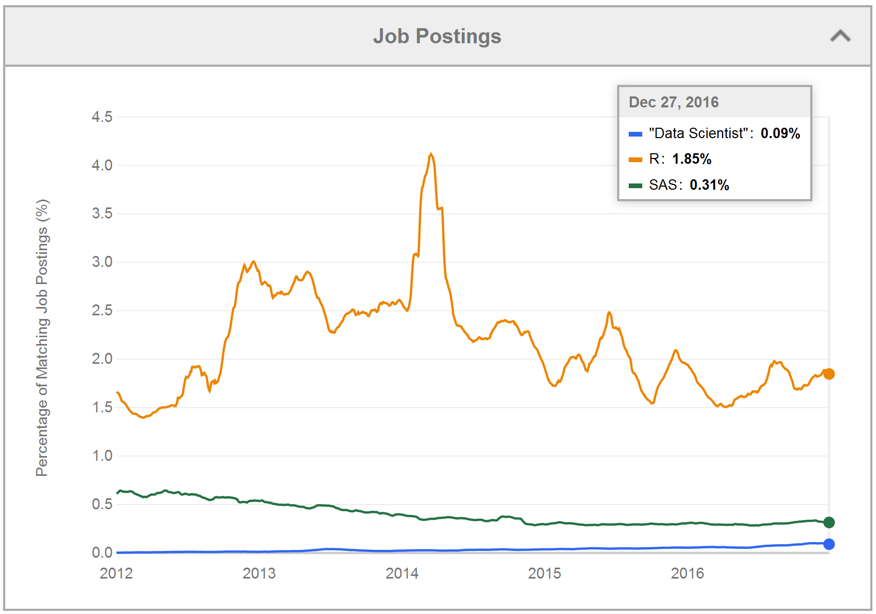
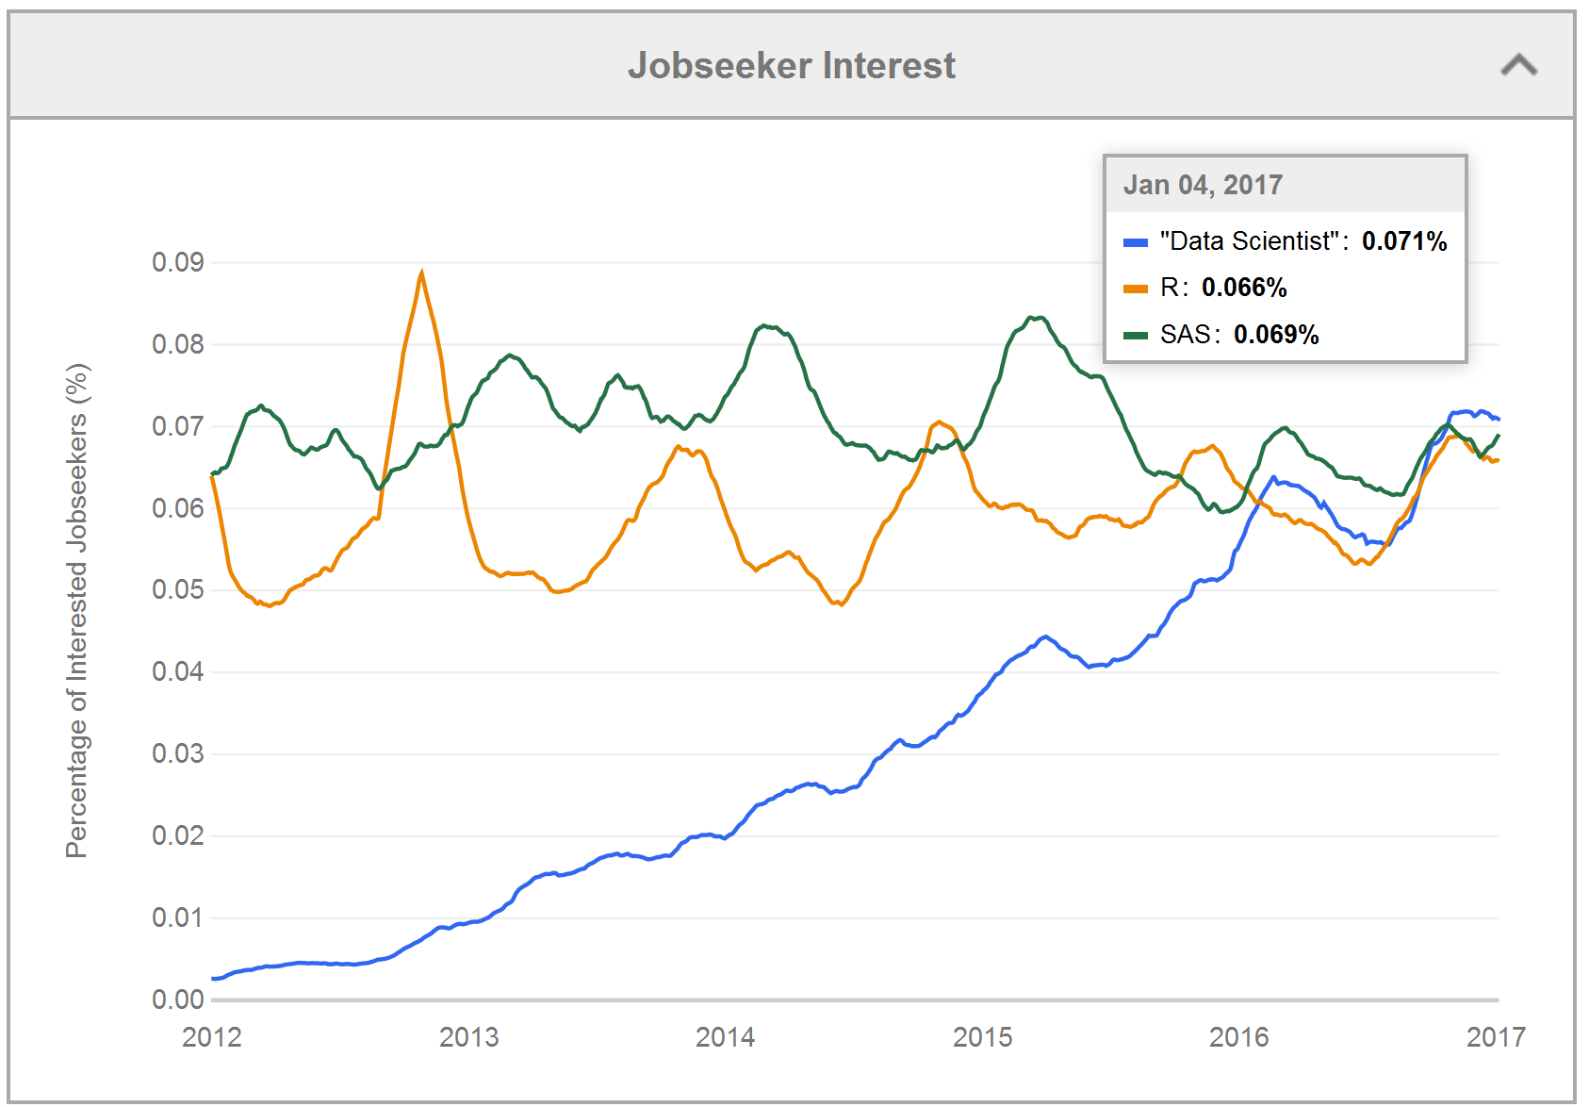
Shifting market for analytics talent
Source: https://www.indeed.com/jobtrends/q-%22Data-Scientist%22-q-R-q-SAS.html

Slide 69

Top reasons to consider Microsoft R Server
1
Microsoft is the recognized leader in R analytics
Delivers the broadest R capabilities available today
Gives R users newfound performance and scale
Maximizes your architectural flexibility
Rapid deployment of intelligent enterprise apps
Harnesses the hybrid cloud
Scales R for big data workloads
Blends best of open source and Microsoft technologies
Provides platform choice
2
3
Replace this picture
4
5
6
7
8
9
10

Slide 70

Getting started with Microsoft R is easy
We created Microsoft R Client to help you get started and train your employees on Microsoft R for free
Spin Up an R Server VM
Explore these Beginners Resources
Explore these Advanced Resources
Try our solutions with these tutorials
or these ready to deploy templates
Notes:
Slide Objective:- Show the value of getting started with Microsoft R with the developer version of R server
Talking Points:-
The developer version of R server is free to use and lets you learn without working with production data
You can explore some beginners resources by clicking on that link
More advanced learning resources are also available
Finally, we have built solution how-tos and created tutorials to help you see the value in Microsoft R
You can find more resources on learning to work with Microsoft R on - Learnanalytics.Microsoft.com
Solution How to examples:-
Marketing Campaign Optimization - https://gallery.cortanaintelligence.com/Solution/Marketing-Campaign-Optimization-2
Hospital Length of Stay - https://gallery.cortanaintelligence.com/Solution/Predicting-Length-of-Stay-in-Hospitals-1
ML Templates with SQL Server R services (tutorial)
https://gallery.cortanaintelligence.com/Collection/ML-Templates-with-SQL-Server-R-Services-1

Slide 71
Getting started /What do we do next?
Get R Tools for Visual Studio
Review Product site
Check out MSDN product page for more detailed info on R Server
Training and video tutorials
A video introduction to R and Microsoft R Server
A tutorial on SAS to R (if u r coming from SAS world)
Get a VM and become hands-on
Azure DataScience VM for development & pre-production use
Azure Microsoft R Server VM Linux VM for development thru production
Azure VM for SQL Server 2016 EE for development thru production
Programming with R for Data Science (EdX course)

Slide 73
History of R

Slide 74

A brief history of R
1993: Research Project in Auckland, NZ
Ross Ihaka and Robert Gentlemen
1995: Released as Open-Source Software
Generally compatible with the “S” language
1997: R Core Group Formed
2000: R 1.0.0 Released
2003: R Foundation Formed in Austria
2004: R 2.0.0 Released, First International User Conference in Vienna
2007: Revolution Analytics founded
2009: New York Times article on R
2013: Revolution R Open released
2015: R 3.2 released
Photo credit: Robert Gentleman

Slide 75




History of R
1995 First open source release
2007 Commercialization of R
2016 Microsoft R Server 9.0 released
2015 R Consortium formed
2001 R Foundation created

Slide 76
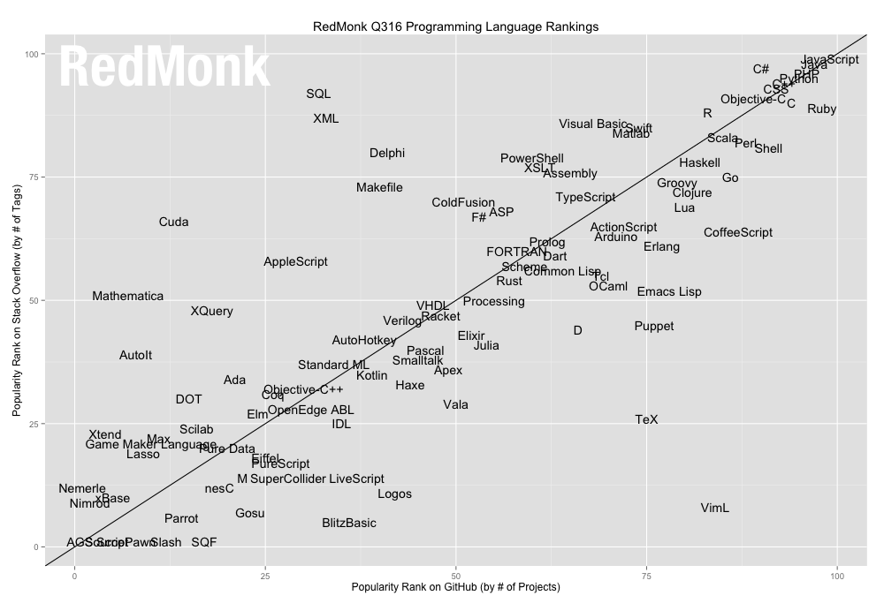
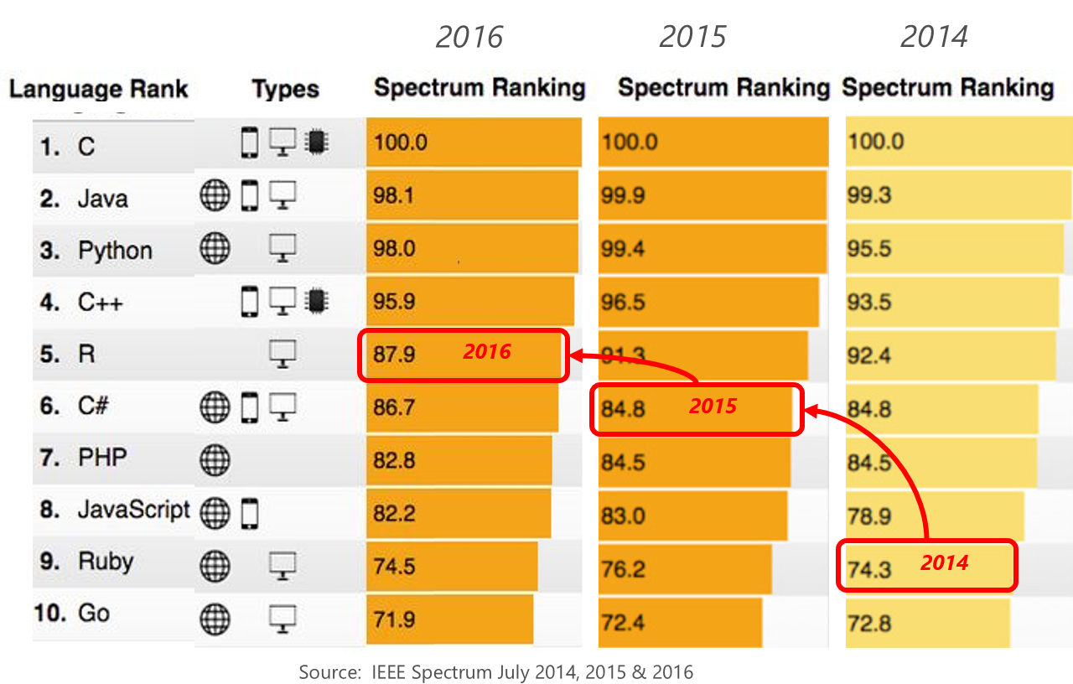
R’s Popularity Growing Among All Languages
#12: R
IEEE Spectrum Top Programming Languages
IEEE Spectrum, July 2014-2016
RedMonk Programming Language Rankings, 2016
Notes:
IEEE had R at 9th in 2014, and 6th in 2015

Slide 77
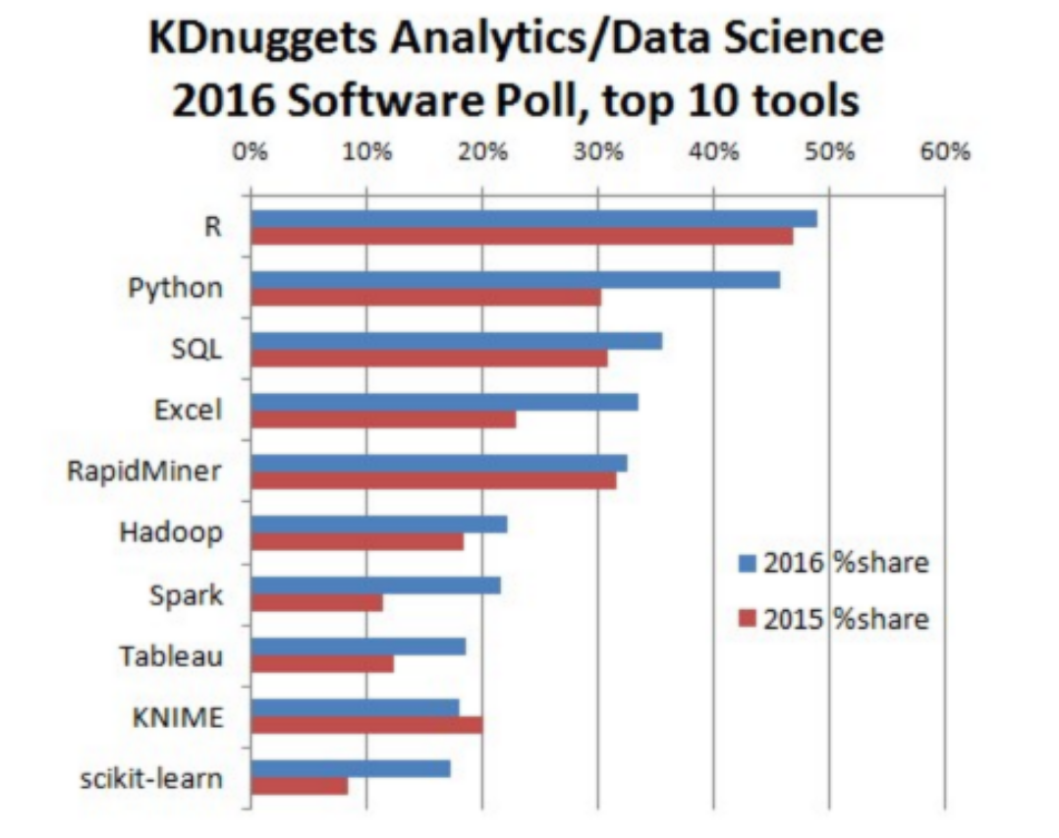
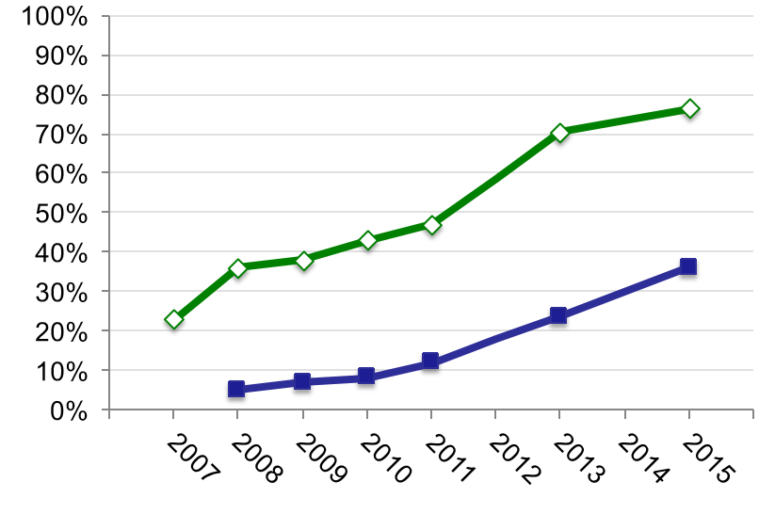
R’s Popularity for Data Science
R Usage Growth
76% of analytic professionals report using R
36% select R as their primary tool
Rexer Data Miner Survey 2007-2015
KDnuggets Top Data Science Tools, 2016
Notes:
IEEE had R at 9th in 2014, and 6th in 2015

Slide 78
What is
#1
Language
Advanced
Analytics
A statistics programming language
Data analysis and visualization capabilities
Strong ties to academia feeds ever-growing machine learning capabilities
3M+
Users
Majority of data scientists use R
New and recent grad’s use it
Thriving user groups worldwide
Open
Biggest
Ecosystem
Vibrant open Source community
10,000 + free algorithms in CRAN
Additional repositorys on Bioconductor & GitHub
Constantly innovating
Notes:
Slide objective
Establish that R is a language is as important for the community that uses it an the capabilities written to extend it than the language itself.
Talking points
Part 1 of the R World is The R language, developed specifically for data analysis – particularly among statisticians and mathematicians.
[optional points]:
Developed in New Zealand, release in roughly 2000.
Maintained by the R Foundation which releases new editions of R every few weeks.
Licensed under GPL open source license.
R directly supports complex data manipulation operations making them extremely simple for users, particularly those with greater depth in statistics and mathematics than in computer science.
Huge community of users across industry, government and academia use R daily.
There are R user groups in most major cities. Some of them very active and very large. Suggest that users look at MeetUp for local groups that meet regularly.
Most important to the value of R is the huge repository of freely exchanged, algorithms, techniques, scripts, adapters, techniques, training available.
Introduce CRAN: “The Comprehensive R Archive Network”.
Data access & integration
Data transformation
Data profiling
Data visualization
Predictive analytics
Machine Learning
CRAN contains over 10000 (and growing) contributed packages. Many algorithms, test data, comments on usage, etc. One package contains hundreds of algorithms packaged as a library.
All are designed to run with the R language.
CRAN is the largest but not the only. Thousands of additional algorithms, visualizations and tools are available from BioConductor, GitHub and other repositories.
Notes

Slide 79
Standing on the Shoulders of Giants
A Vast Community of R Users Share Rich Repositories of Pre-Built Solutions
CRAN: The Comprehensive R Archive Network
Resources For All Fields of Analysis
10,000+ Packages
+ Bioconductor + Github
Notes:
R is the most widely used language for data advanced analytics
Used by 2M+ data scientists, statisticians and analysts
Most powerful statistical programming language
Flexible, extensible and comprehensive for productivity
Create beautiful and unique data visualizations
As seen in New York Times, The Economist and FlowingData
Thriving open-source community
Leading edge of analytics research
Fills the talent gap
New graduates prefer R

Slide 80
Today's… (and Tomorrow's) … Challenges

Slide 81


Common predictive analytics challenges…
Cost
$
Architecture
Talent Shortage
?
Delay
=∑(
Collaboration
)
Deployment Flexibility
Data Explosion
Risk
Notes:
Slide Objective: To show the top barriers to deriving value from analytics, namely – High cost, talent shortage, low productivity and working with data that lives in different places.
Talking Points
Talk about the barriers to deriving value from Analytics and how Microsoft deal with them. Also contrast with how many of these challenges are faced by SAS customers.
Talk about the high total cost of ownership of SAS. Complex licensing and pricing. Microsoft R has a much lower cost of ownership and can be licensed easily based on whatever your current analytics environment is.
Talent is another major barrier. Universities aren’t teaching legacy tools like SAS and the S language. Every university grad in a data related field learns how to code in R. Investing in R is about investing in the future of analytics
Employees in data related roles spend a lot of time preparing the data and operationalizing their models. While Microsoft doesn’t solve for the data prep challenge (nor does any other company), Microsoft does make it easy to operationalize models. Microsoft’s advanced analytics product portfolio makes your data scientists more productive.
Easily works with data that lives both on premise and in cloud – Microsoft R works with all major platforms both on premise and in the cloud allowing you to easily do analytics on that data. It is much harded with tools like SAS to work with data that lives in different places because their tools are build on different platforms.

Slide 82
Microsoft R helps address these challenges
Microsoft R solves open source R challenges
Microsoft R solves open source R challenges
Scale
Performance
Operationalize
Support
Scales from workstations to large clusters; scales to large data sizes
Growing portfolio of transparently parallelized and Microsoft Machine Learning algorithms
Write Once Deploy on multiple platforms— on-premises and cloud
Solution templates, enterprise level support, partner eco-system
Notes:
Slide Objective:
Talk about the limitations and challenges of Open Source R and show how Microsoft R deal with those challenges. If the option of Open Source R comes up in the discussion, this slide can help deal with why not go with open source R.
Talking Points
Scale - Open Source R is bound by disk memory limitations which makes it hard to scale to bug data. Microsoft R give you the chances to scale to large data sizes by pushing analytics to the data.
Performance – Open Source R is single threaded which limits the performance of analytics in open source R specially with large data sizes. Microsoft R introduces multithreaded parallelized libraries to give you enterprise grade performance irrespective of data sizes.
Operationalize – ____________________ Microsoft R makes it easy to operationalize your models within the database or in applications. Microsoft R also works on multiple platforms making it easy to reuse your R script across platforms, increasing the productivity of your data scientists.
Support – Microsoft R gives you 24/7 enterprise grade support – so you know who to contact if any problems arise.

Slide 83
Challenges to Analytic Application Adoption
Talent Scarcity
Strong Competition for Scarce Talent
Academic Knowledge Requirements
Data Integration Effort Requirements
Low Productivity
Platform Complexity Surprises
Tool and Skill Gaps
Culture Gaps between IT & Data Science
Complex Infrastructure
Data Integration Costs
Development Delays
Rapidly Evolving Big Data Landscape
Slow Innovation
Lack of Data Science Agility
Complex Deployment Practices
Haltingly Slow Model Production
Notes:
Today the power of machine learning for advanced analytics is only being utilized by a very small group, requiring highly trained and specialized data scientists to create and nurture models for them to be useful.
In this young market, there are still many complexities.
First, the huge investment necessary to even get started with machine learning keeps most companies out completely. Both the technology itself and the specialized team needed to make it work are just too expensive. With our solution you literally need just a Microsoft Azure subscription.
Second, the data management side can be really cumbersome, posing unnecessary limitations on what data can be included in models. Our ML solution contains its own storage space in the cloud and is seamlessly connected to HDInsight, SQL Server in a Virtual Machine, SQL Database, Blobs and Tables.
Third, collaborating across technologies, let alone geographies, is difficult and limits participation in exploring data and building predictive models. It’s just not that easy to use, so people end up struggling with the technology instead of focusing on the business problem at hand. With our solution data scientists can share their workspaces with colleagues securely with a click.
Finally, and maybe most discouraging considering the investments involved, many models never achieve business value because it’s so hard to deploy them to production. Imagine spending hundreds of thousands of dollars on a solution and having it never see the light of day. You can see why machine learning has been so niche up to this point. Most revolutionary of all, our models can be deployed to production in minutes, allowing data scientists to show value to the business at the speed of the market.
Why is this possible? The power of the cloud.

Slide 84
Diversity of Challenges Faced
The Business
Analytics Driven Competitiveness
IT
Modeling Productivity
Data Science Team
Data
Talent Maximization
Tool Choice
Collaboration
Scope of Utilization
Tools
Agility
Offload Unnecessary Burden
Tools
Ingest Infrastructure
Management Governance Platforms
Platforms
Democratization
Operationalization
Expanding Diversity
Storage Costs
Time To Value
Modernization
Depth of Insights
Net New Revenue Streams

Slide 85
Challenge: Lack of Agility
Load
Explore
Model
Test
Re-Code
Validate
Deploy
Modeling
Conversion
3 – 6 Months
Results:
Slow Innovation Rates
Stale Models
Errors
Extended Testing & Validation Cycles

Slide 86






Challenge: Expanding Stakeholder Audience
Data Science
Team
Business Executive
Business Analyst
Data Engineering
Decisions
Analytical Data Lake
Operational Apps
Data Steward
Application Developer

Slide 87
Challenge: Rapidly Evolving Big Data Platforms
MapReduce
YARN
Spark
??
< 3 years
Cloud Maturing as Data Both Source & Data Repository
On-Prem Platforms like Hadoop Evolving Rapidly
Results:
High Risk to Analytical Investments Due to Platform Disruption
Unpredictable Cost & Schedule
Adverse Impace Upon Data Science Productivity

Slide 88
Challenge: Alignment with Cloud Plans
Fit
Risk
Agility
Security
Elasticity
Lack of Experience
TCO
Transition Cost
Adopt
Wait

Slide 89
Challenge: Invisible Spend
Departmental or Product Level Licensing
Many organizations are unaware of their total analytics spend.
$
$
$
$
$
£
£
£
£
Country- by Country Licensing
¥
¥
¥
¥
¥
€
€
€
€
€
Rp
Rp
Rp
Rp
. . .
. . .
. . .
. . .
. . .
. . .

